Slide 1


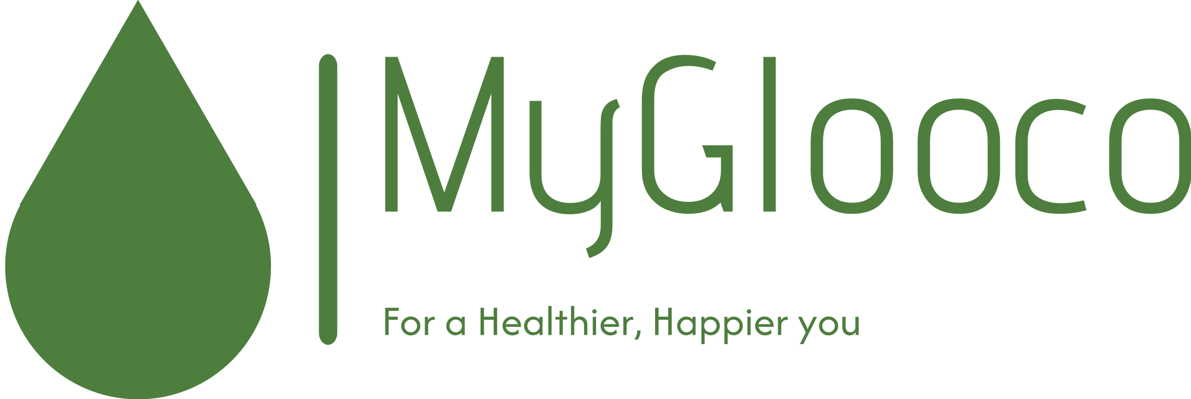
MyGlooco
Personalizing Diabetes Management

Slide 2
The Problem
Steady rise in the annual diabetes rates
Lack of personalization in traditional diabetes management tools

Slide 3
Our Solution
MyGlooco is a personalized diabetes management application designed to simplify treatment and care

Slide 4
What does MyGlooco do?
Tracks blood sugar levels
Logs diet and provides nutrition insights
Monitors physical activity
Manages medication intake and reminders
Offers educational resources on diabetes care

Slide 5
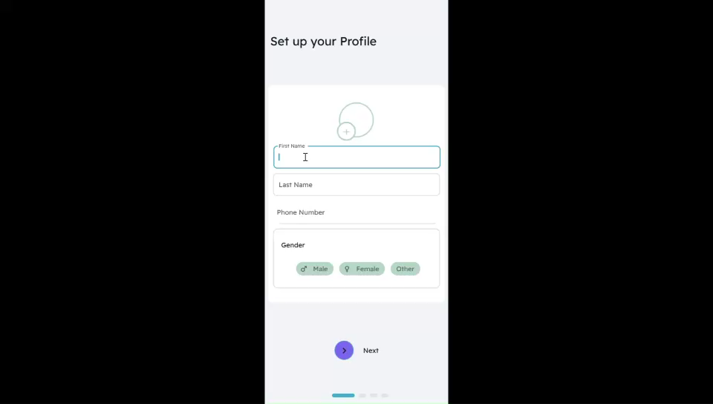
Program Flow

Slide 6
Challenges Encountered
Difficulty in finding a suitable dataset for blood sugar prediction model training
Absence of a localized food database

Slide 7
Our Future
Addition of a machine learning model to predict blood sugar levels
Integration with blood sugar trackers for automatic inputs

Slide 8



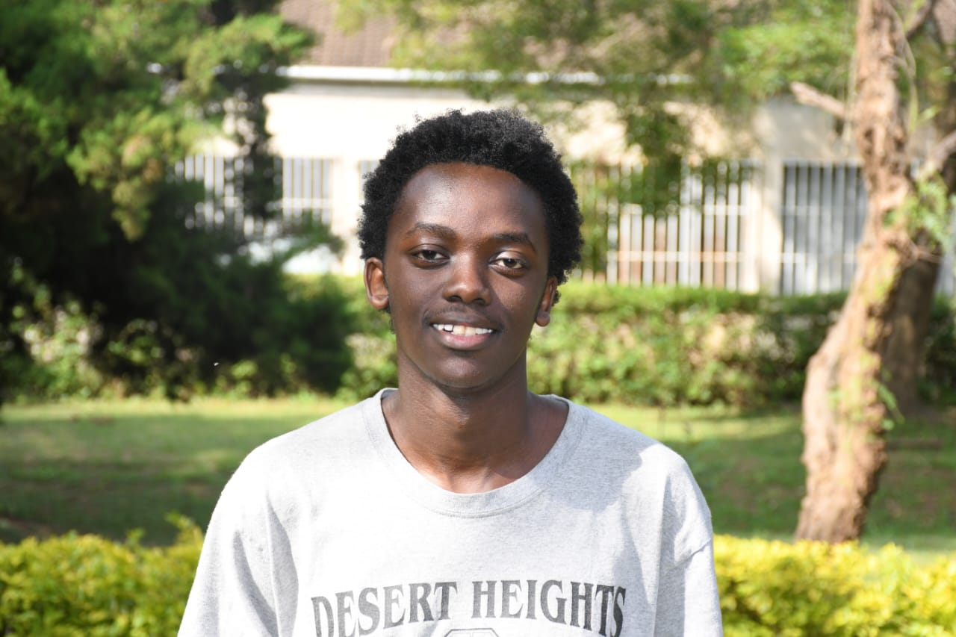

MEET THE TEAM
Backend Dev
UI/UX Designer
Frontend Dev
Joseph Muema
Jayden Mathenge
Terry Mutheu
Database Dev
Frontend Dev
Joseph Njenga
Kelly Kasina

Slide 9


Thank You!
Contact us
+254798730844
@josephmuema443@gmail.com

